Slide 1
ANALYSIS AND VISUALIZATION OF US PRESIDENTIAL RESULTS FROM 2016 AND 2020
Presented by 4 Maskateers
Team Members: Anand Sharan,
Alanna Javier, Donna Tigrett,
and Elizabeth Koehler

Slide 2

OBJECTIVE
Analyze and visualize US Presidential Results between 2016 and 2020 to find trends in voting patterns and identify possible reasons for those trends.

Slide 3
DATA SOURCES
Townhall.com for 2016 election data
The New York Times for 2020 election data
The US Census Bureau Voting and Registration
Notes:
for the 2016 election results at the county-level we used result published by Townhall.com. Their well-formatted county-level result tables for the 2016 presidential general election, which makes it easy for a web scraper like beautifulsoup to capture results. Link.
2020 election results at the county-level are
scraped from results published from and the New York Times.
Voter Registration & Demographics:
The US Census Bureau Voting and Registration

Slide 4







2016 Election Results ETL Process
Notes:
Our ETL process for the 2016 dataset we

Slide 5

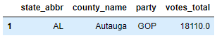
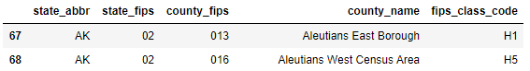
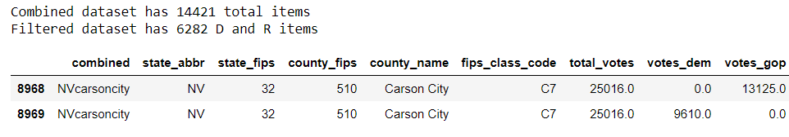
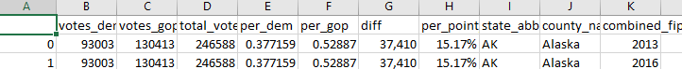
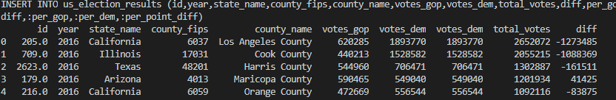
2016 Election Results Data Preparation
01
TOWNHALL RESULTS
02
HTTPS REQUESTS AND API AND PREPROCESS CENSUS
03
COMBINE DATASETS
04
EXPORT COUNTY-LEVEL RESULTS TO CSV FILE
05
LOAD DATA INTO SQLLITE DATABASE
Notes:
Town hall results show state_abb, county ,party, votes_total. Then we

Slide 6

2020 Election Results ETL Process

Slide 7
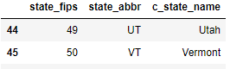
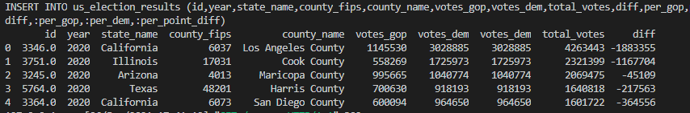
2020 Election Results Data Preparation
01
NEW YORK TIMES
02
HTTPS REQUESTS AND API AND PREPROCESS CENSUS
03
COMBINE DATASETS INTO PANDAS DATAFRAME
04
EXPORT COUNTY-LEVEL RESULTS TO CSV FILE
05
LOAD DATA INTO SQLLITE DATABASE

Slide 8








Slide 9


Slide 10
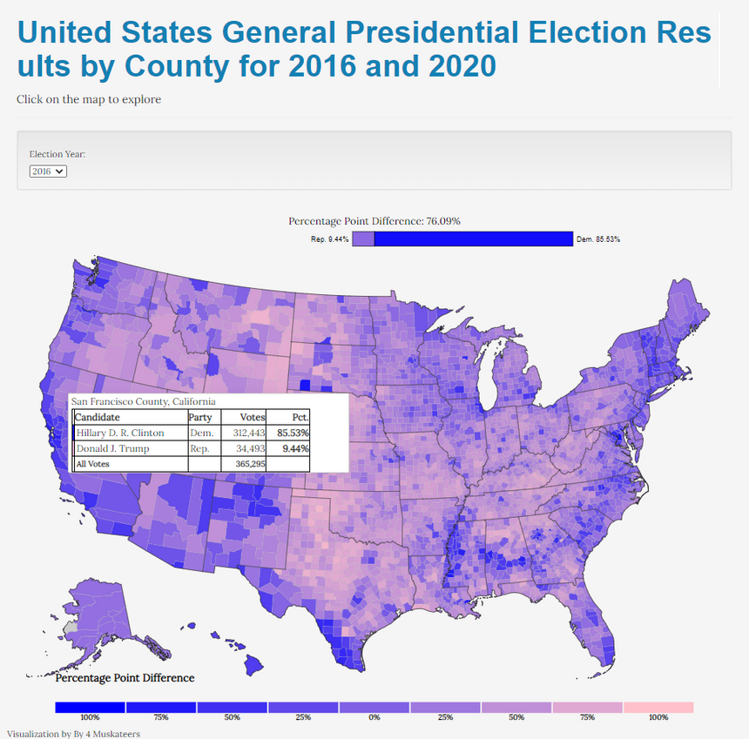
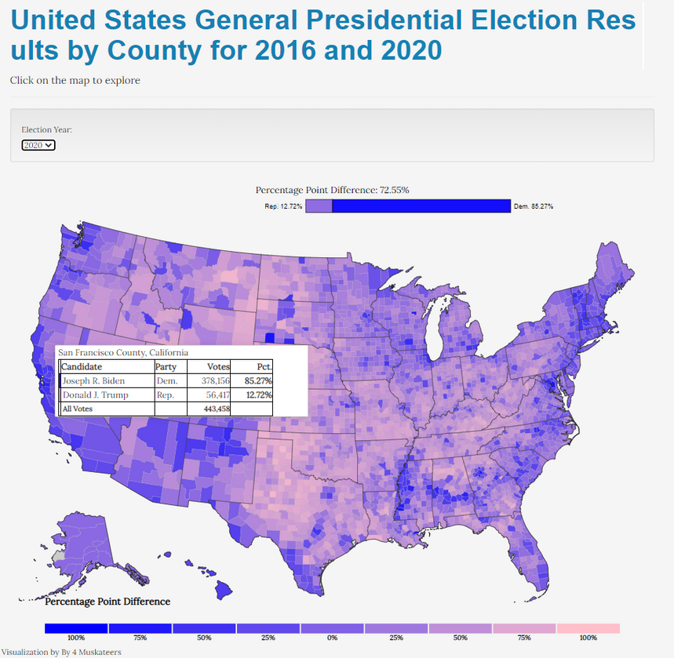
Election Results Visualizations
2016 ELECTION
2020 ELECTION
Notes:
We used D3 chloropleth maps to create this visual. Here we wanted to show you that the map is interactive and when we hover over SF county it shows the candidate, party, votes and percentage. the dem votes decreased by 0.26% and GOP votes increased by 3.28%

Slide 11
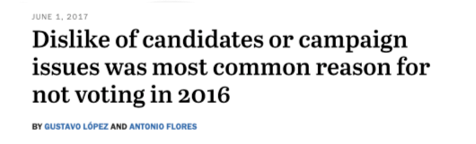
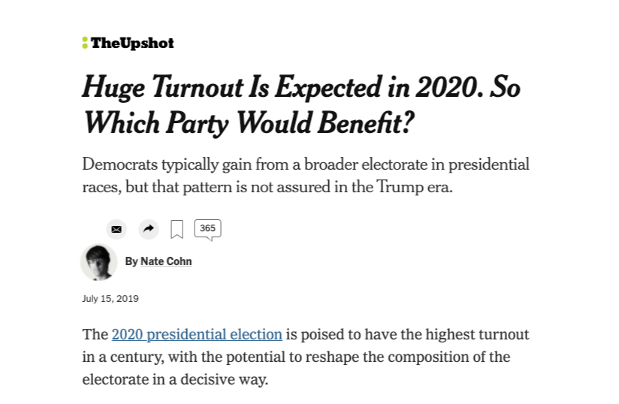
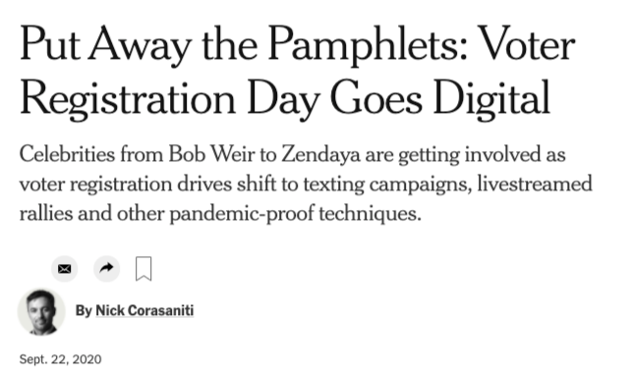
WHAT CHANGED?
Notes:
Voter Turnout was a major theme in the media between the 2016 and 2020 Presidential Elections, so we wanted to dive deeper into the actual data to see if we could uncover an explanation as to Joe Biden won the Presidential Election.

Slide 12
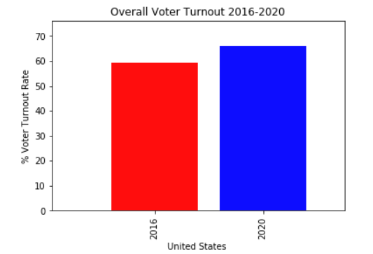
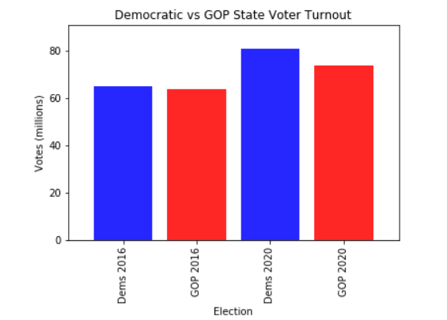
ANALYZING VOTER TURNOUT
Notes:
Overall voter turnout increased in 2020 resulting in a Dem win for the popular votes. On the "dem vs. gop state voter turnout" chart there were slightly more dem voters than GOP in 2016.
there was an increase of voter turnout for both parties, but dem resulting in an overall win.

Slide 13
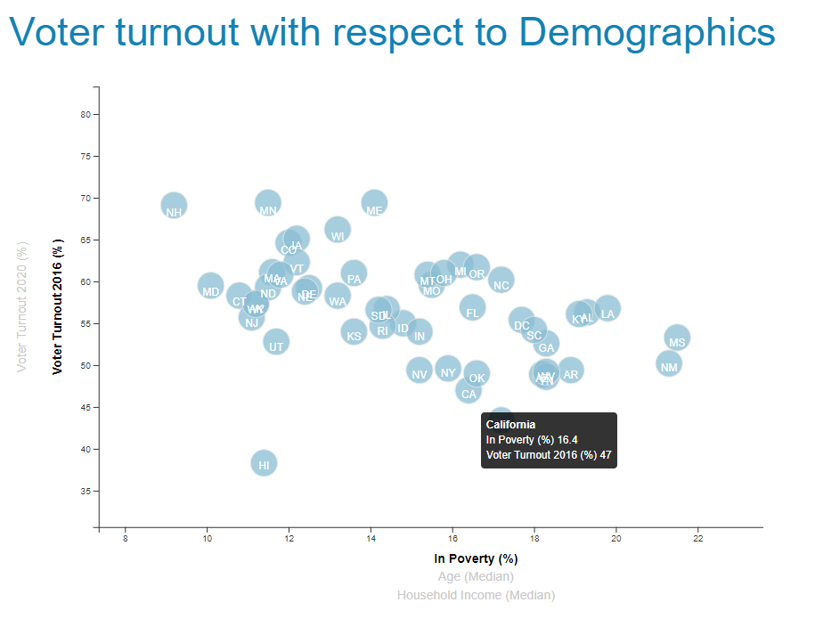
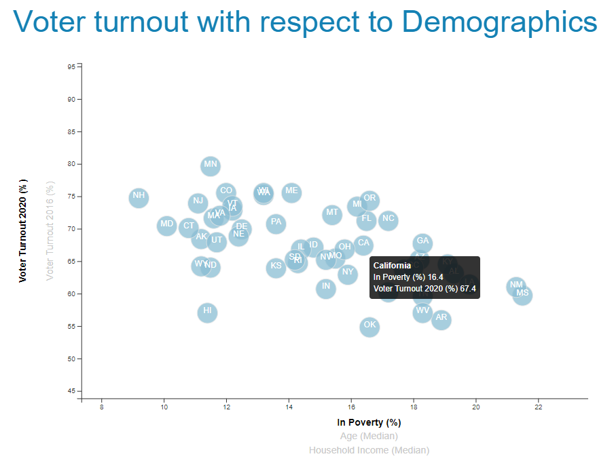
2016 & 2020 VOTER TURNOUT VS. % OF THE POPULATION LIVING IN POVERTY
2016
2020

Slide 14
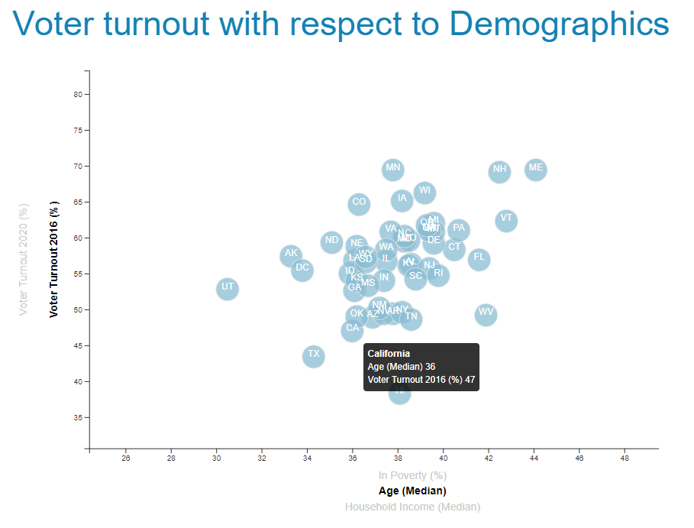
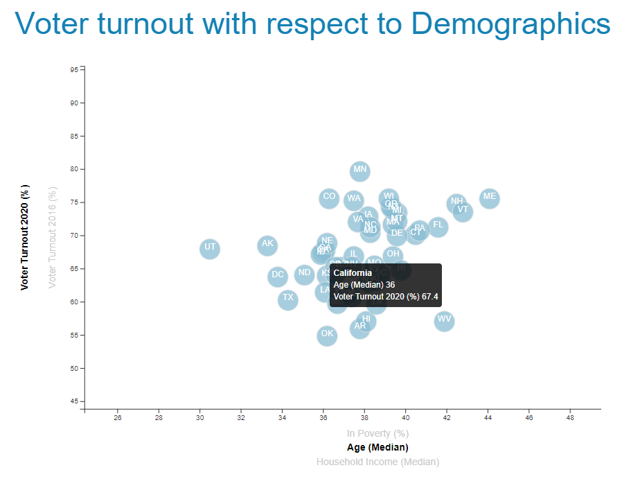
2016 & 2020 VOTER TURNOUT VS. AGE
2016
2020

Slide 15
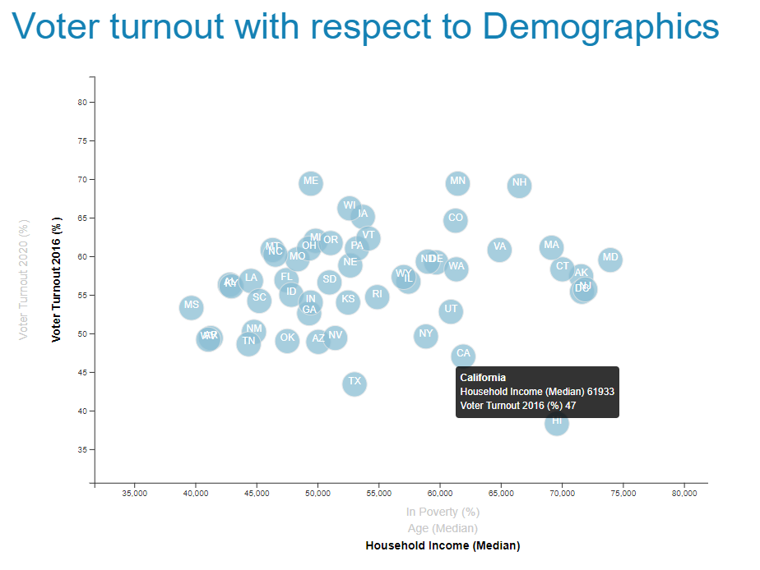
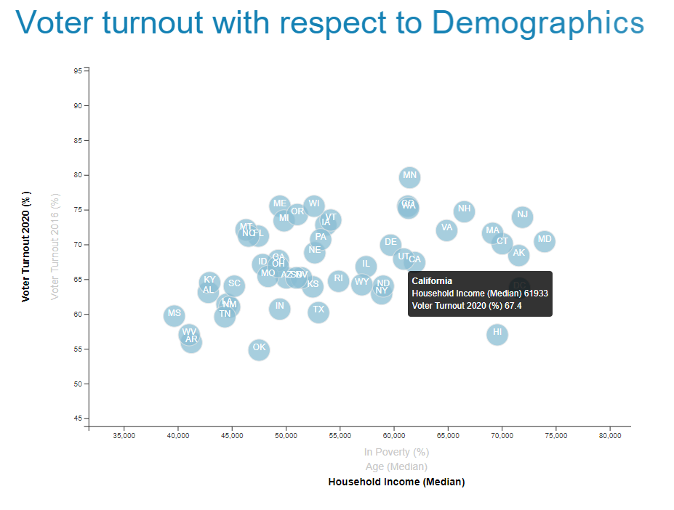
2016 & 2020 VOTER TURNOUT VS. MEDIAN HOUSEHOLD INCOME
2016
2020

Slide 16
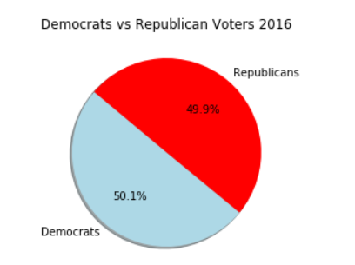
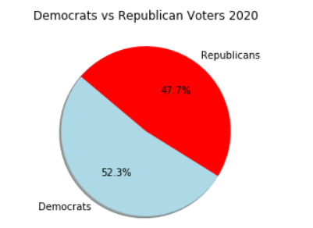
VOTER TURNOUT AND PARTY ANALYSIS
Notes:
Total votes in 2016 was 129,972,639. Dems cast 65 million (50.1%) GOP cast 64 million (49.9%).
Total Votes in 2020 was 155, 473,866. Dems cast 81 million (52.3%) GOP cast 74 million (47.7%)

Slide 17
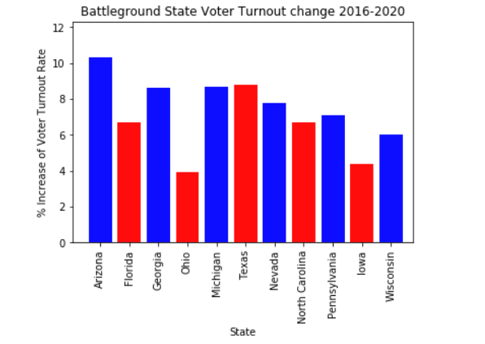
SWING STATE ANALYSIS
Notes:
Increase between 2016 and 2020 Voter Turnout Rates in Key Battleground. Of Significance were the following:
Arizona had an increase of 10.30%
Michigan had an increase of 8.70%
Georgia had an increase of 8.60%
Nevada had increase of 7.8%
Texas had an increase of 7.70%
Penn had an increase of 7.10%
Florida had an increase of 6.70%
Wisc had an increase of 6%
Noteworthy that AZ, GA, WI, MI, PA flipped from red to blue in the 2020 election.

Slide 18

APPLY MACHINE LEARNING
TO PREDICT VOTER BEHAVIOR
What compels a person to select a candidate?
COLLECT GENERALIZED DATA
Factors that motivate people to vote.
Learn what overall Demographics want and need based on generalized data.
FIND CORRELATIONS
Examine turnout rates and voter patterns of behavior.

